Slide 1


Company Profile
The company was founded in 2022 with a mission to provide technology solutions that support digital transformation and business efficiency.
www.scitforte.com

Slide 2


About Us
Software development, information technology, and cloud services.
A software powerhouse with ready-made products and customizable solutions tailored to diverse industries.

Slide 3

Vision
To become the leading technology company by providing innovative solutions that drive global business advancement. Empowering innovation through cutting-edge technology solutions that drive growth and efficiency.
Mission
To develop technology that enables businesses to transform digitally, increase efficiency, and achieve significant business outcomes. Delivering exceptional products and tailored solutions for evolving business challenges.
The company was founded in 2022 with a mission to provide technology solutions that support digital transformation and business efficiency.

Slide 4

Company Values
Integrity – Building trust through transparency and honesty.
Innovation – Leading with cutting-edge solutions.
Excellence – Delivering top-quality products and services.
Collaboration – Achieving success together, with clients and teams.
Customer-Centricity – Focused on delivering client success.
Sustainability – Committed to responsible, eco-friendly practices.
Adaptability – Embracing change with agility.
Empowerment – Enabling growth through support and knowledge.
Impact – Creating lasting positive change for society.

Slide 5
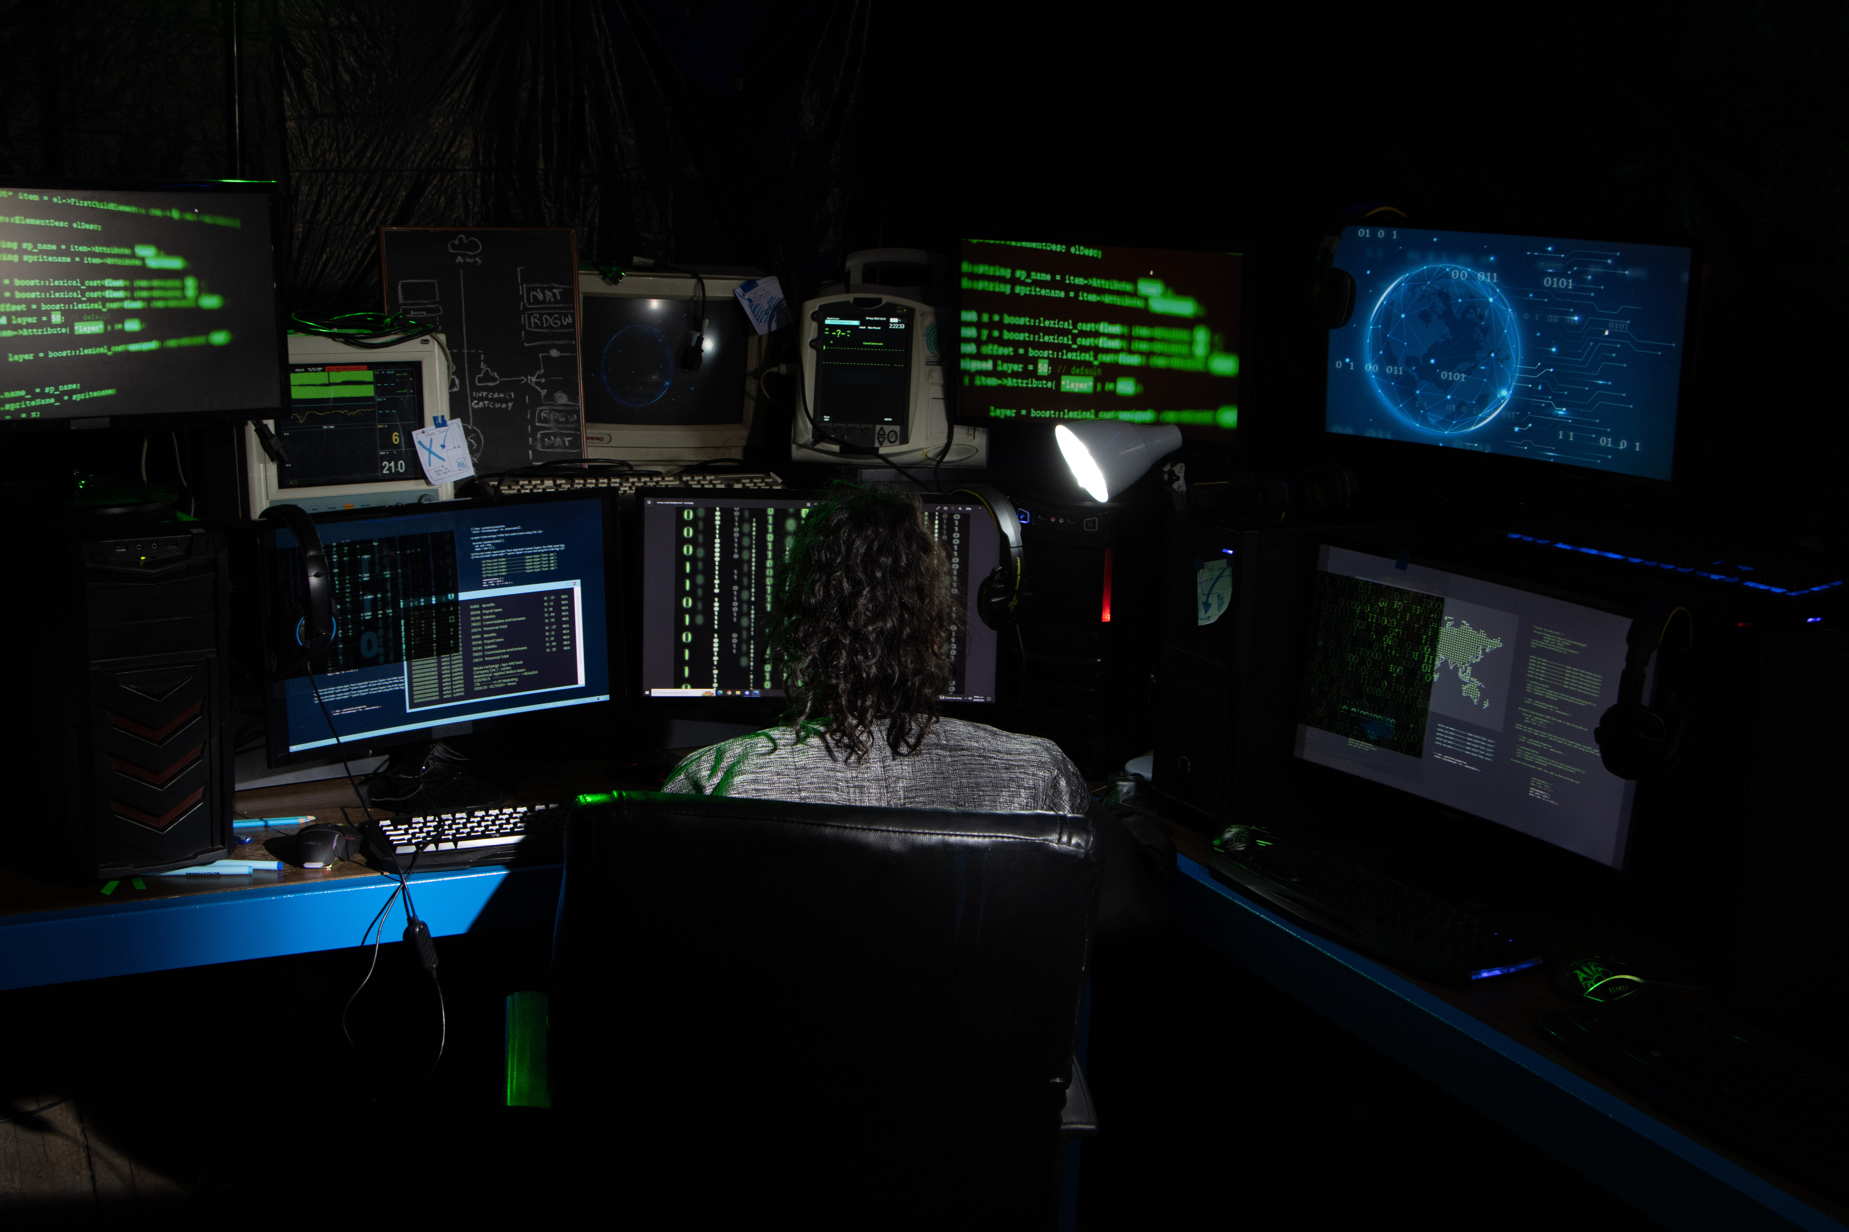
Technology Stack
ScitForte leverages a robust technology stack to deliver high-quality solutions. Our expertise spans a range of modern technologies, including .NET Core for backend development, React JS for dynamic front-end applications, and PHP Laravel for scalable and efficient web solutions.
For mobile app development, we use Flutter, React Native & Ionic, ensuring cross-platform compatibility and seamless user experiences. Additionally, providing a smooth integration of web technologies with native functionality. This diverse stack enables us to build powerful, flexible, and high-performing systems for our clients across various industries.

Slide 6
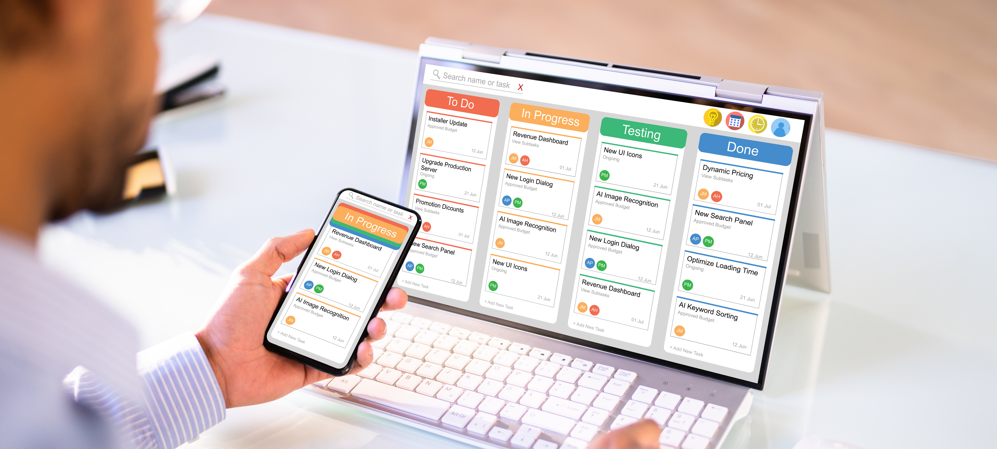
Products & Services
Quality and Advantages
Our solutions are designed using cutting-edge technology, provide 24/7 customer support, and are customizable to meet each client’s specific business needs.
Latest Innovations
We offer a variety of technology products, ranging from ERP systems to mobile applications, designed to improve business performance. Our latest innovation, an AI-powered ERP system, allows businesses to work smarter and more efficiently through cloud technology.

Slide 7

Core Products
Osprey:
Strategy tracking, project management, and workflow automation.
Task prioritization, time tracking, and financial integration.
AgriFatt:
Specialized for livestock management and operational optimization.
ESGenius
Sustainability reporting aligned with global standards.
Smart Care:
Empowering Hospitals, Enhancing Lives
Smart REMS:
A smart solution for land and real estate management

Slide 8
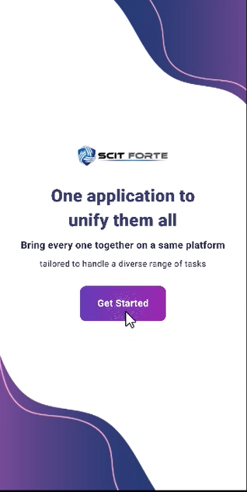
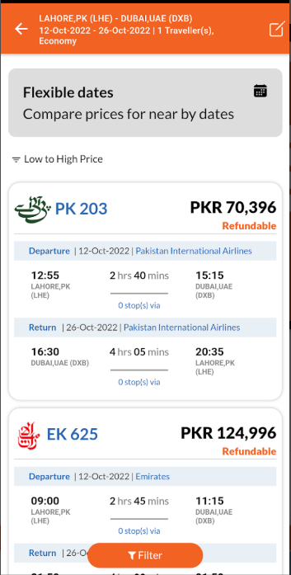
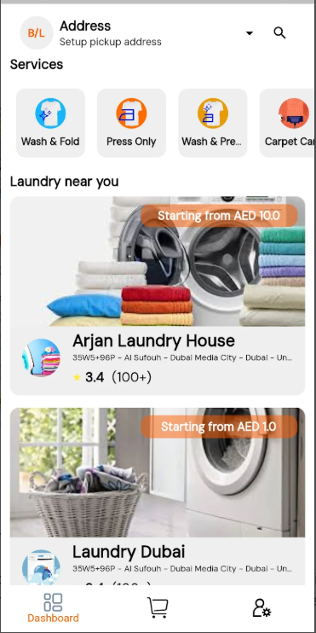
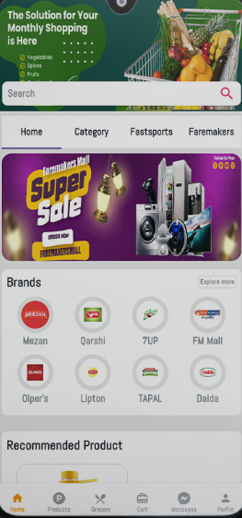
Mobile Applications

Slide 9
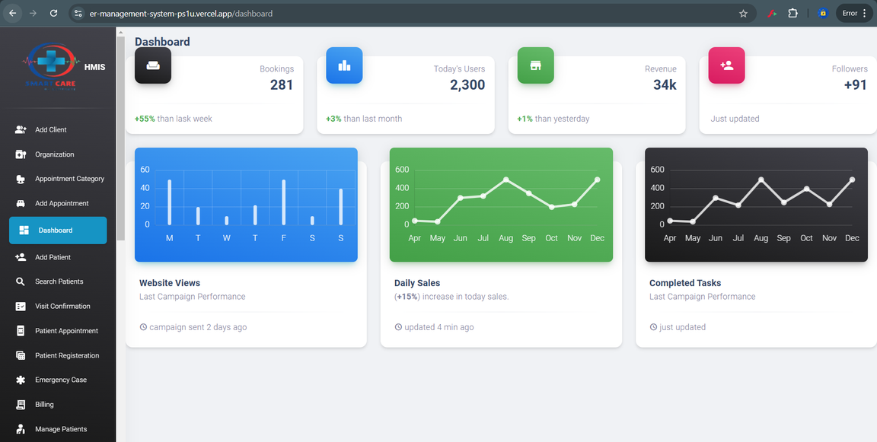
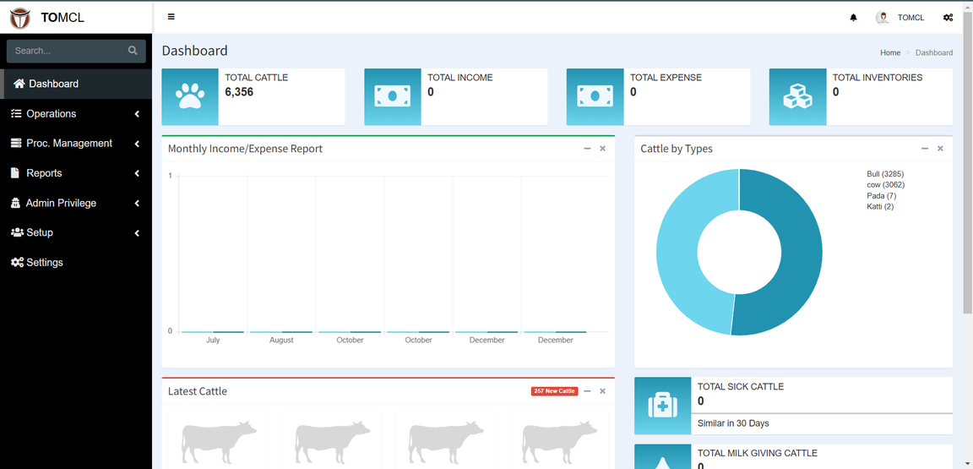
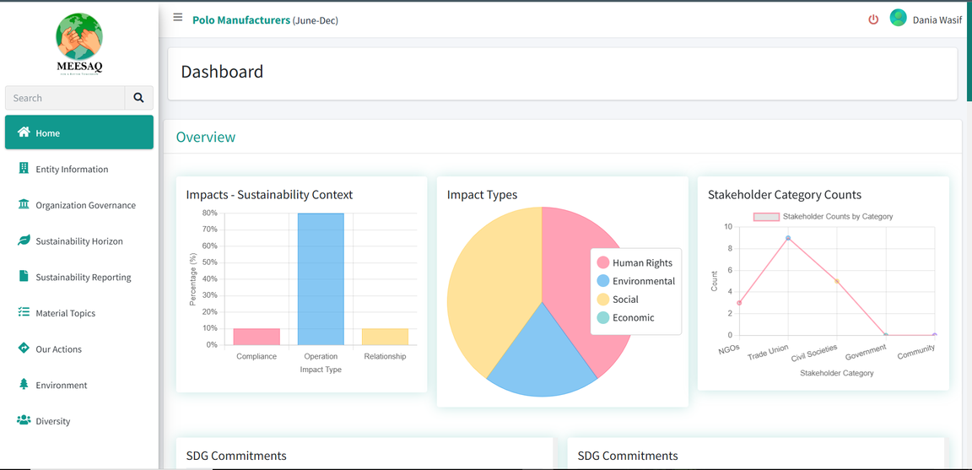
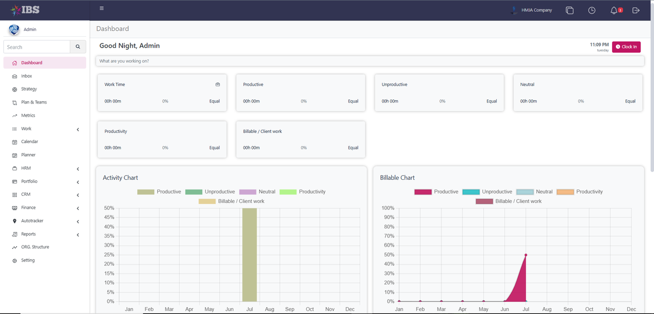
Web Portals

Slide 10
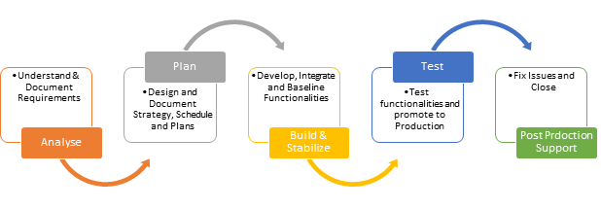
Our Methodology

Slide 11

Our Services
Custom Software Development: Tailored solutions for specific business needs.
Mobile and Web Platforms: Scalable applications for diverse use cases.
Digital Marketing Solutions: SEO, PPC, and analytics-driven campaigns.
Cloud and Hosting Solutions: From domain registration to VPS and PaaS setups.
AI-Powered Insights: Real-time analytics for smarter decision-making.

Slide 12








Major Achievements
We are proud to have received several awards and certifications that recognize the quality of our work. Our major projects showcase our expertise in serving key clients across various industries.
Awards
Affiliates

Slide 13


Clients & Market
Target Market
ScitForte's target market includes Small to Medium Enterprises (SMEs), Large Enterprises, Healthcare Sector, Real Estate Developers, Agriculture and Livestock, Environmental and Sustainability-focused Organizations, Logistics and Supply Chain, Education & Government, and Tech Startups and Innovators.
Key Client
ScitForte has worked with clients like Amadeus, Faremakers, and TOMCL on ERP solutions and ticketing platforms. We’ve also collaborated with Growive, JBS, and State Life Insurance Corporation on innovative software projects. Other clients include Pakistan Navy, RIMS Trauma, Skyblue Lab, ICE Tube, and Atiya General Hospital, where we delivered tailored systems, along with a Laundry App for a UAE client.

Slide 14














Clientele

Slide 15




Contact Us
We are ready to collaborate with you. Contact us through the details below for more information on our products, services, or partnership opportunities with Scitforte.
Scitforte Technologies
+92 345 8808088
info@scitforte.com
www.scitforte.com
Office # 101, Building 91-C, 11th Jami Commercial Street
D.H.A Phase 7, Karachi.

Slide 16
Thank you!
The company was founded in 2022 with a mission to provide technology solutions that support digital transformation and business efficiency.
www.scitforte.com

